Slide 1

Models of Organisational structure.
Work Related learning Week 6

Slide 2
Learning Outcomes.
Be
At the end of this session, students will be able to;
Explore
1-Explore Models Of Organisational structure.
Explain
2-Explain Elements Of Organisational Structure .

Slide 3
LO1-Activity-Individual Research -10mins
Conduct an individual research ;
What is organisational structure ?

Slide 4
Organisational structure.
An organizational structure is a system that outlines how certain activities are directed in order to achieve the goals of an organization. These activities can include rules, roles, and responsibilities. The organizational structure also determines how information flows between levels within the company.
An organizational structure defines how activities such as task allocation, coordination, and supervision are directed toward the achievement of organizational aims.
Organizational structure affects organizational action and provides the foundation on which standard operating procedures and routines rest. It determines which individuals get to participate in which decision-making processes, and thus to what extent their views shape the organization's actions. Organizational structure can also be considered as the viewing glass or perspective through which individuals see their organization and its environment.

Slide 5
LO2-Activity -10mins
Research on the following ;
Four Basic Elements of Organizational Structure !!.

Slide 6
Four Basic Elements of Organizational Structure
Functional Organization Structure ;
Under a functional organization structure, people who do similar tasks are grouped together based on specialty. So all the accountants are placed in the finance department and so on for the marketing, operations, senior management and human resources departments.
The advantages of this kind of structure include quick decision making, because the group members can easily communicate. They can also learn from each other, since they already possess similar skill sets and interests.

Slide 7
Elements Of Organisational structure.
Divisional Structure Based on Products;
In a divisional structure, your company groups workers into teams based on the products or projects that meet the needs of a certain type of customer. For example, a bakery with a catering operation might structure the workforce based on key clientele, such as a wedding department and a wholesale-retail department. The division of labor in this kind of structure ensures workers making similar products can achieve greater efficiency and higher output.

Slide 8
Elements Of Organisational structure….
Matrix Structure Combines Functional and Divisional Models;
A matrix structure combines elements of the functional and divisional models, so it’s more complex. It groups people into functional departments of specialization, then further separates them into divisional projects and products.
In a matrix structure the team members are given more autonomy and expected to take on more responsibility for their work. This increases the productivity of the team, fosters greater innovation and creativity, and allows managers to cooperatively solve decision-making problems through group interaction. This type of organizational structure takes lots of planning and effort, making it appropriate for large companies that have the resources to devote to managing a complex business framework.

Slide 9
Flat Organizational Structure
A flat organizational structure attempts to disrupt the traditional top-down management system of most companies. Management is decentralized so there is no everyday “boss.” Each employee is the boss of themselves, eliminating bureaucracy and red tape and improving direct communication.
For example, an employee who has an idea doesn’t have to wade through three levels of upper managers to get the idea to the key person making the decision. The employee simply communicates directly with the target on a peer-based level.
A company adopting this type of structure for everyday purposes typically establishes a special top-down management system for temporary projects or events.

Slide 10
Types of organizational structures
Hierarchical org structure
Functional org structure
Horizontal or flat org structure
Divisional org structures (market-based, product-based, geographic)
Matrix org structure
Team-based org structure
Network org structure.

Slide 11
Hierarchical org structure.
The pyramid-shaped organizational chart we referred to earlier is known as a hierarchical org chart. It’s the most common type of organizational structure––the chain of command goes from the top (e.g., the CEO or manager) down (e.g., entry-level and low-level employees) and each employee has a supervisor.

Slide 12
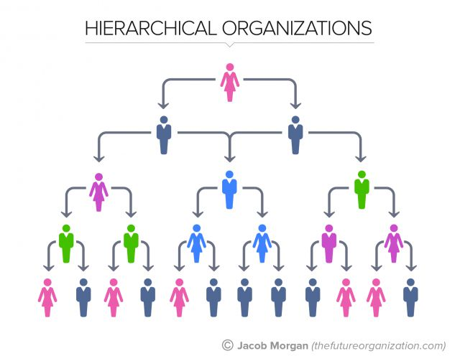
Hierarchical org structure.

Slide 13
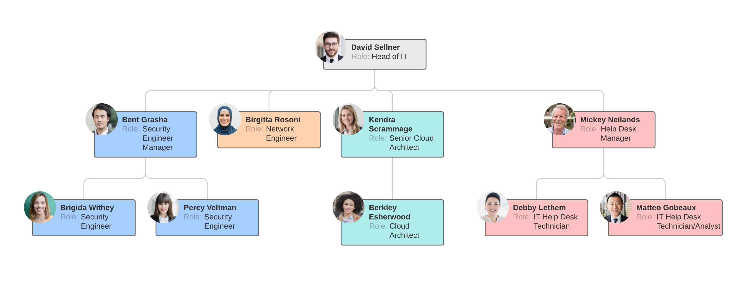
Functional org structure.

Slide 14
Functional org structure.
Similar to a hierarchical organizational structure, a functional org structure starts with positions with the highest levels of responsibility at the top and goes down from there. Primarily, though, employees are organized according to their specific skills and their corresponding function in the company. Each separate department is managed independently.

Slide 15
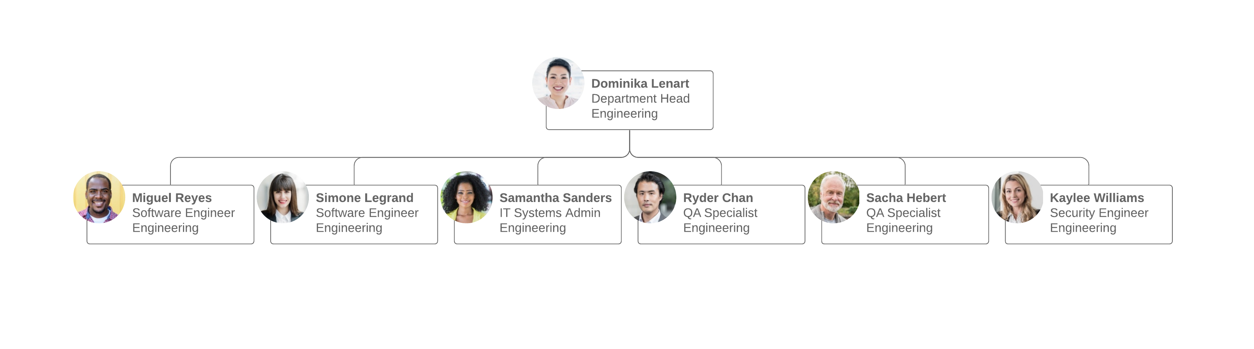
Horizontal or flat org structure

Slide 16
Horizontal or flat org structure.
A horizontal or flat organizational structure fits companies with few levels between upper management and staff-level employees. Many start-up businesses use a horizontal org structure before they grow large enough to build out different departments, but some organizations maintain this structure since it encourages less supervision and more involvement from all employees.

Slide 17
Divisional org structure
In divisional organizational structures, a company’s divisions have control over their own resources, essentially operating like their own company within the larger organization. Each division can have its own marketing team, sales team, IT team, etc. This structure works well for large companies as it empowers the various divisions to make decisions without everyone having to report to just a few executives.
Depending on your organization’s focus, there’s a few variations to consider.

Slide 18
Market-based divisional org structure
Divisions are separated by market, industry, or customer type. A large consumer goods company, like Target or Walmart, might separate its durable goods (clothing, electronics, furniture, etc.) from its food or logistics divisions.

Slide 19
Product-based divisional org structure
Divisions are separated by product line. For example, a tech company might have a division dedicated to its cloud offerings, while the rest of the divisions focus on the different software offerings––e.g., Adobe and its creative suite of Illustrator, Photoshop, InDesign, etc.

Slide 20
Geographic divisional org structure
Geographic divisional org structure
Divisions are separated by region, territories, or districts, offering more effective localization and logistics. Companies might establish satellite offices across the country country or the globe in order to stay close to their customers.

Slide 21
Matrix org structure
A matrix organizational chart looks like a grid, and it shows cross-functional teams that form for special projects. For example, an engineer may regularly belong to the engineering department (led by an engineering director) but work on a temporary project (led by a project manager). The matrix org chart accounts for both of these roles and reporting relationships.

Slide 22
Team-based org structure
It’ll come as no surprise that a team-based organizational structure groups employees according to (what else?) teams––think scrum teams or tiger teams. A team organizational structure is meant to disrupt the traditional hierarchy, focusing more on problem solving, cooperation, and giving employees more control.

Slide 23
Network org structure
These days, few businesses have all their services under one roof, and juggling the multitudes of vendors, subcontractors, freelancers, offsite locations, and satellite offices can get confusing. A network organizational structure makes sense of the spread of resources. It can also describe an internal structure that focuses more on open communication and relationships rather than hierarchy.

Slide 24
Reference list.
Lee, S.M., Luthans, F. and Olson, D.L., 1982. A management science approach to contingency models of organizational structure. Academy of Management Journal, 25(3), pp.553-566.
Child, J., 1972. Organizational structure, environment and performance: The role of strategic choice. sociology, 6(1), pp.1-22.
Hannan, M.T., Freeman, J.H. and Meyer, J.W., 1976. Specification of models for organizational effectiveness. American Sociological Review, 41(1), pp.136-143.

